Slide 1
YOLO-CFAR Reproduction
林郁庭(2021)。基於YOLO之雷達目標偵測演算法。國立清華大學通訊工程研究所碩士論文，新竹市。 取自 https://hdl.handle.net/11296/7n49t5
Advisor: Dr. Chih-Yu Wang
Presenter: Shao-Heng Chen
Date: July 06, 2022

Slide 2
Objectives
1. RD map data generation
– generate raw RD map data and store as .jpg / .jpeg files
– resize images to 416 x 416, originally 875 x 656
– annotate the dataset with Pascal VOC XML format, or COCO format
2. Run YOLOv3 [1]
– successfully run any version of YOLOv3, optimally Keras version
– try to train with RD map dataset from scratch
1
[1] YOLO-Reproduce-Summary (https://hackmd.io/@Shao-Heng/BJLlV3Zjq)

Slide 3
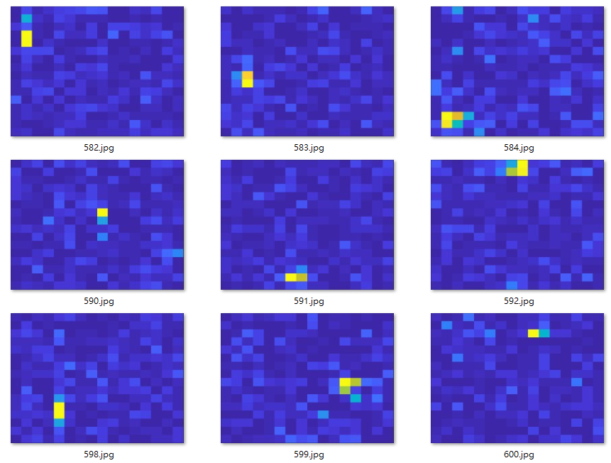
RD map
– Firstly, generate 600 figures to test the water
2

Slide 4
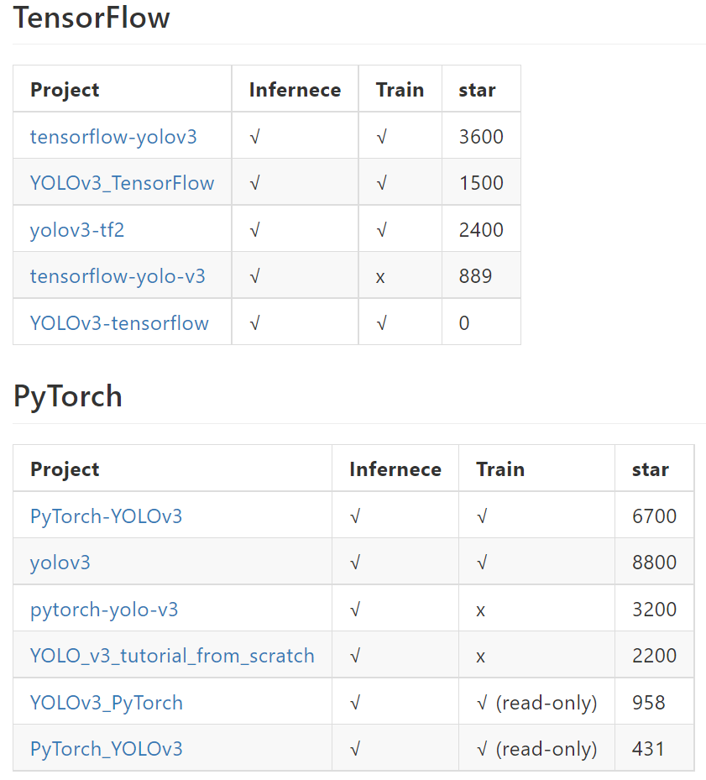
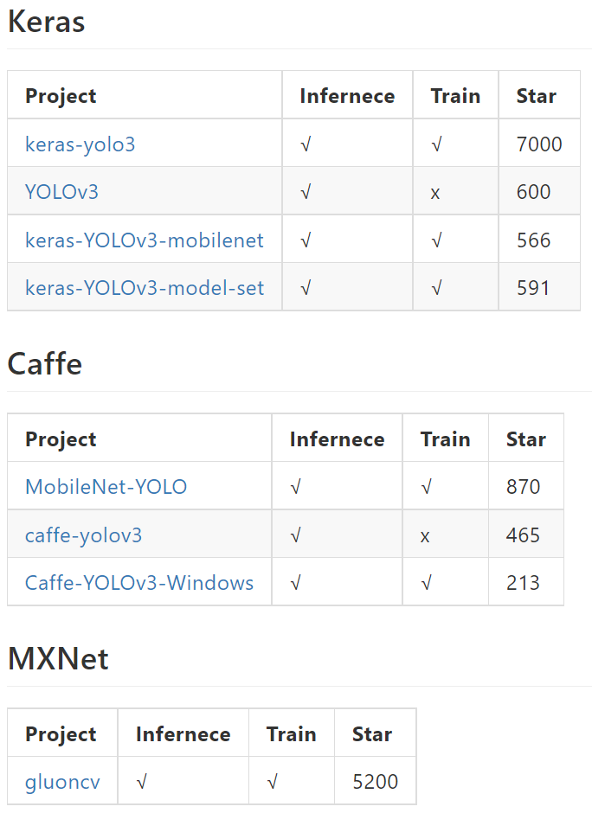
YOLOv3
– Tensorflow, PyTorch, Keras and other frameworks implementations of YOLOv3
3

Slide 5
Issues
1. Original keras-yolo3 version and keras-YOLOv3-mobilenet version fails
– Install requirements are Python 3.5.2, Keras 2.1.5, tensorflow-gpu 1.6.0
2. keras-YOLOv3-model-set version runs on Ubuntu 18.04
– Install requirements are Python 3.6.8, tensorflow-gpu 1.15.0, tf.keras 2.2.4-tf
3. Inference is slow, roughly 0.1 fps, tested on Intel i7-8700 + Geforce RTX 2060
4

Slide 6
Future Works
– Try tf.keras, Tensorflow or PyTorch implementations
– Try other bounding box prediction algorithm
– Try other one stage objector detectors like Single Shot Detector (SSD)
– Dig deep into RD map data generation
5

